Slide 1
Laptop Comparision
Computer Product Suggestion

Slide 2


Problem definition
Give 2 or 3 laptop products, find out the best of them.

Slide 3
Solution
Determine 5 types of laptop’s hardware
which are the most customer will be interested in when buying a laptop
Chipset (CPU)
Graphic card (VGA)
Memory (RAM)
Hard disk (HDD)
Screen solution
Source: http://bit.ly/cps-survey-summary

Slide 4
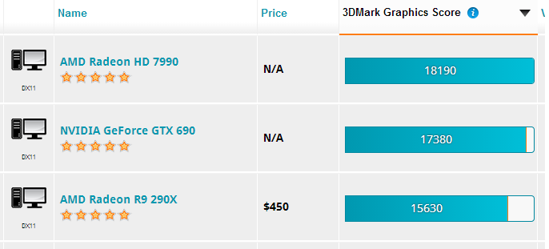
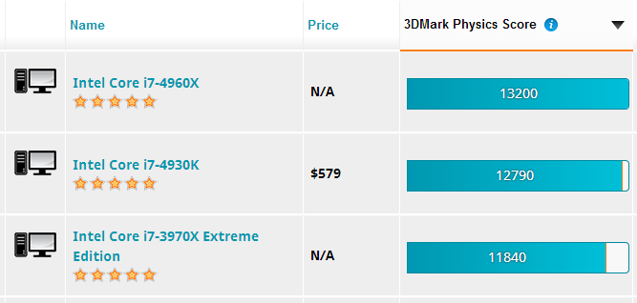
Solution
Get the score of CPU and VGA
Chipset (CPU)
Graphic card (VGA)
Memory (RAM)
Hard disk (HDD)
Screen solution
parse
Source: http://futuremark.com/hardware/

Slide 5
Solution
Make a reduction the score of CPU and VGA on the scale from 1 to 100
Website’s score | CPS’s core
Highest score | 100
Other

Slide 6
Solution
Set the score of RAM, HDD and Display base to 100 scale
Chipset (CPU)
Graphic card (VGA)
Memory (RAM)
Hard disk (HDD)
Screen solution
Hardware | CPS’s core
The best specific value | 100
Other

Slide 7
Solution
Product’s score
Hardware’s name | Score
Chipset (CPU) | c
Graphic card (VGA) | v
Memory (RAM) | r
Hard disk (HDD) | h
Screen solution | s
(Prior hardware)

Slide 8
Source: http://bit.ly/cps-survey-summary

Slide 9
Source: http://bit.ly/cps-survey-summary

Slide 10
Solution
Product’s score
Hardware’s name | Score
Chipset (CPU) | c
Graphic card (VGA) | v
Memory (RAM) | r
Hard disk (HDD) | h
Screen solution | s
Product’s score =

